Slide 1
Firefly Services
Developer Presentation and Labs

Slide 2
Agenda
Go over the prerequisites for this session
What?
Why?
How?
Labs
Notes:
What and why will be Slide Deck, How will be a combination of slides and code.

Slide 3
Prerequisites

Slide 4
What You Need
Firefly Services credentials (CLIENT_ID and CLIENT_SECRET)
Node.js (v20 or higher)
An editor of any sort (Visual Studio Code recommended!)
Cloud storage + credentials (for some labs)
AWS S3
Dropbox
Azure
Notes:
For Cloud storage, we will share a link to a file with some useful helper S3 functions.

Slide 5

Assets
Slide deck, demos, labs: https://github.com/cfjedimaster/fireflyservices-preso
Notes:
Note that if you get this repo with the labs, it presents the solutions – so no cheating please!
ToDo: More links

Slide 6
What are Firefly Services?

Slide 7
Firefly Services
Automation solution for content generation at scale
Set of Services (grouped into various “families”)
Notes:
Move from high level marketing to firmer details
note –maybe mention SDK?
Services are APIs, but ok to not say here I think

Slide 8
Service Families
Photoshop
Lightroom
Firefly
Content Tagging (not covered today)

Slide 9
Photoshop APIs
Various APIs related to automating aspects of Photoshop
Requires Cloud storage for operations
Examples:
Execute Photoshop Actions
Create Renditions
Remove Background
Docs: https://developer.adobe.com/firefly-services/docs/photoshop/

Slide 10


Photoshop API Examples
Action and ActionJSON endpoints let you automate incredibly complex workflows
With ActionJSON, you can modify workflows on the fly
Notes:
Note these examples cover SOME of the APIs

Slide 11

Photoshop API Examples
Smart Object lets you dynamically replace items in an image

Slide 12

Photoshop API Examples
Text endpoint lets you change text of a layer
Including formatting and style

Slide 13
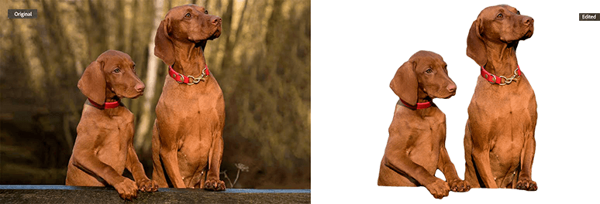
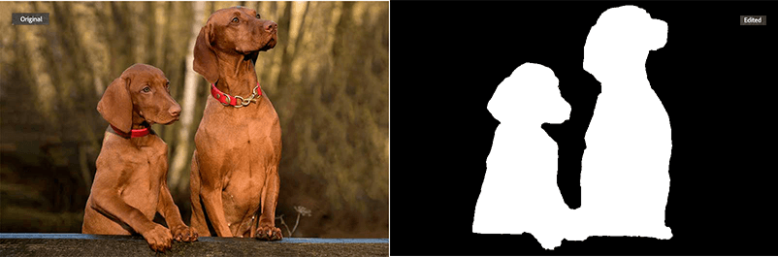
Photoshop API Examples
Remove Background and Generate Mask
Notes:
I feel like most folks grok RB, but GM maybe not so much

Slide 14
Lightroom APIs
Various APIs related to automating aspects of Lightroom
Requires Cloud storage for operations
Examples:
Auto Straighten
Auto Tone
Apply Presets
Docs: https://developer.adobe.com/firefly-services/docs/lightroom/

Slide 15
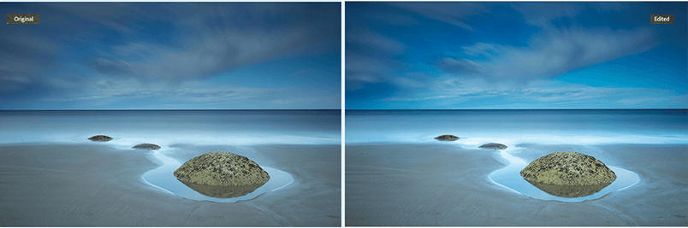
Lightroom API Examples
AutoTone applies multiple improvements to an image using AI/ML
Notes:
First example is a bit subtle

Slide 16


Lightroom API Examples
Notes:
Better example

Slide 17
Firefly APIs
Generative AI APIs
Mirrors (mostly) what’s available at firefly.adobe.com
Examples:
Text to Image
Generative Expand
Generate Similar
Docs: https://developer.adobe.com/firefly-services/docs/firefly-api/

Slide 18
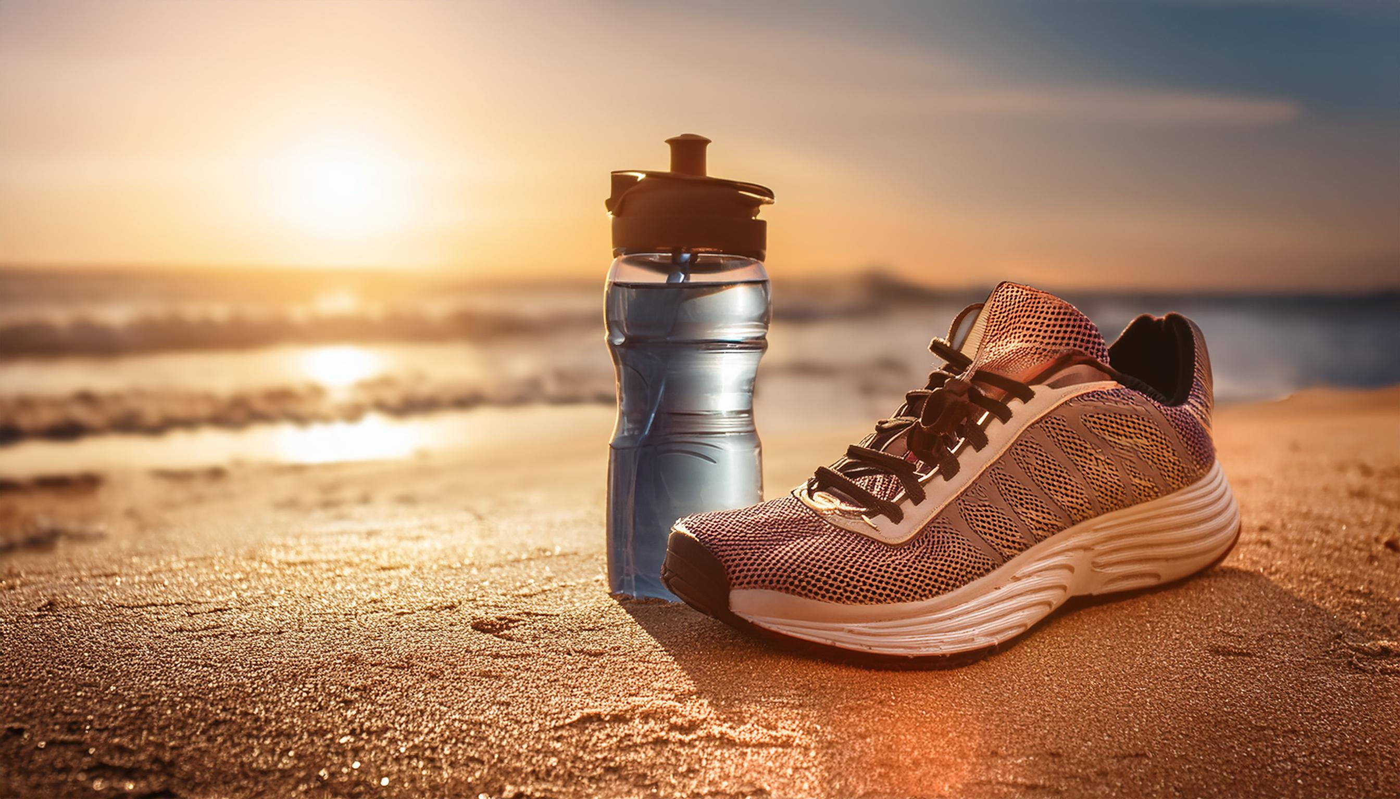
Firefly API Examples
Text to image with prompt, “an athletic sneaker and water bottle on a beach, sunny day”
Notes:
We start simple... given just a prompt, we can generate an image
However, the API provides _multiple_ controls over the image

Slide 19

Firefly API Examples
You can specify “Art” versus “Photo”
Notes:
Same prompt, using art

Slide 20


Firefly API Examples
Style presets (huge list of styles) - like “cool tone”, “beautiful” and “chaotic”
Notes:
Styles shown are: Painting and Futuristic
Note – Same prompt

Slide 21
Firefly API Examples
Can copy a style from another image
Can copy structure from another image

Slide 22
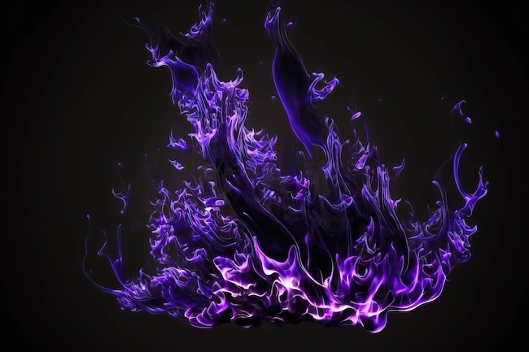

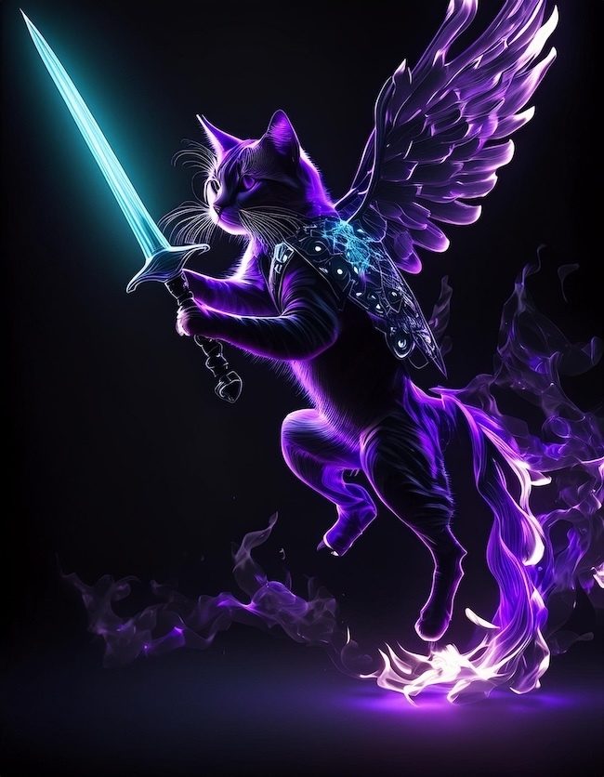
Notes:
Taking a source image, and using the _same_ prompt, here (click once) is what you get w/o the style reference, and here is how it changes WITH the style ref

Slide 23

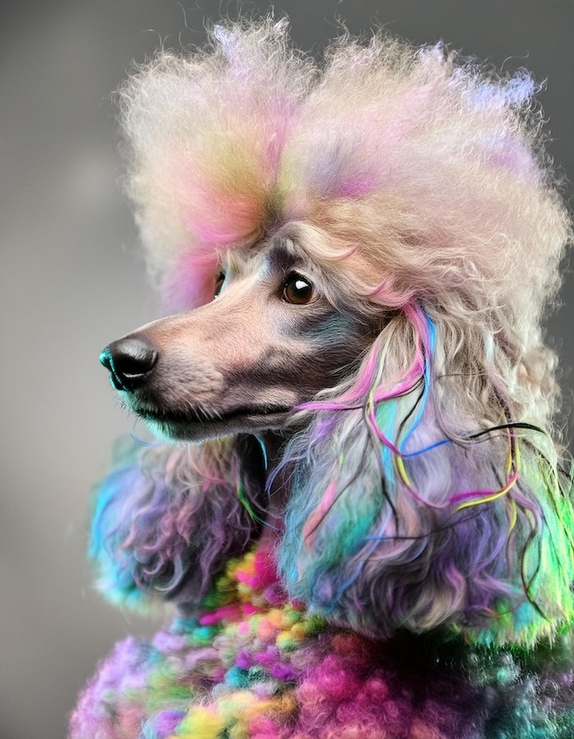
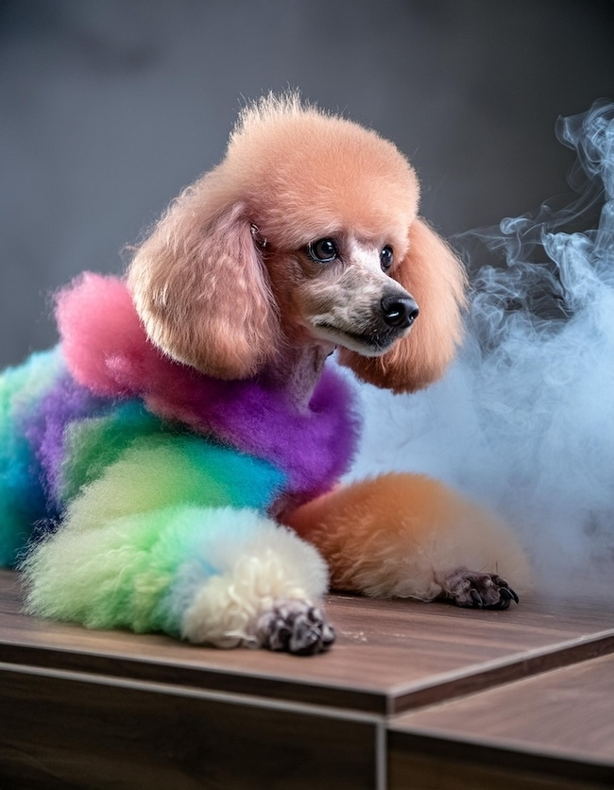
Notes:
in this example, the initial image is used as a structure ref, and again, using the same prompt, here’s an image WO using it, and here’s one WITH using it

Slide 24
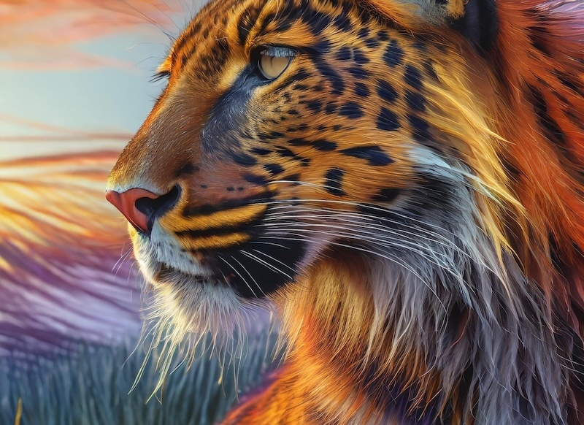
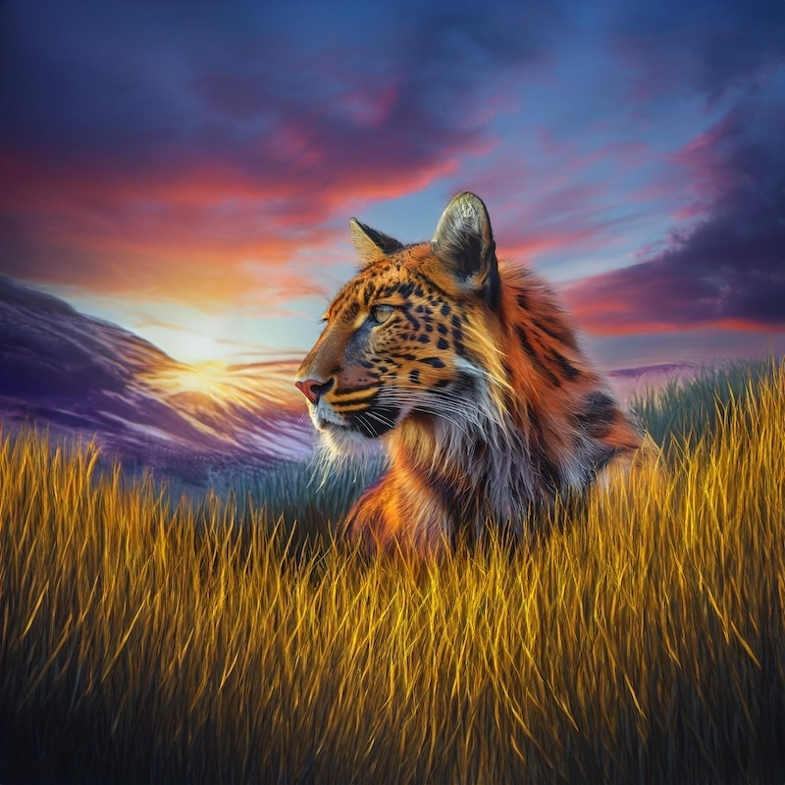
Firefly API Examples
Expand Image can either – just expand... or use a prompt to drive the new content
Notes:
first, an example of expand with no prompt, FF just figures it out

Slide 25

Firefly API Examples
Prompt: “The sun is rising in the background and trees are visible.”
Notes:
first, an example of expand with no prompt, FF just figures it out

Slide 26
Content Tagging APIs
Content tagging and organization APIs
Examples:
Keyword tagging
Color tagging
OCR
Docs: https://experienceleague.adobe.com/en/docs/experience-platform/intelligent-services/content-commerce-ai/overview
Notes:
Reminder – we aren’t demonstrating this today.

Slide 27
Why do we need these APIs?

Slide 28
What problems do Firefly Services solve?
Workflow Automation
Asset Generation
Notes:
content automation – basically automating workflows via photoshop
generation – automating creating _new_ asset

Slide 29
Workflow Automation – An Example
Agency needs to create media assets
Of different sizes – different campaigns – different languages
Photoshop API can automate creating renditions from an artboard with variations of text and translations – all in one process

Slide 30
Asset Generation – An Example
Agency needs to create media assets
Of different sizes – different campaigns – different languages
Photoshop API can automate creating renditions from an artboard with variations of text and translations – all in one process
Firefly API can use GenAI to create new images
Firefly API can then generatively expand new images for different sizes
Notes:
This builds on the example from the last slide

Slide 31
How do we use them?

Slide 32
General Flow
Exchange credentials (client_id and client_secret) for an access token value
Call the endpoint
For Firefly APIs, your result is in the response
For Photoshop/Lightroom, your result is a URL (Job)
Ping the job URL to monitor the result
Remember – will be in cloud storage only
Notes:
Note on last bullet, cloud storage, we don’t share this as a bad thing, just a reminder that if your working with stuff locally and need the PS API, you will need to incorporate CS as a temporary storage location, shuttling assets up and down

Slide 33
Reference Docs
Firefly: https://developer.adobe.com/firefly-services/docs/firefly-api/guides/api/image_generation/V3/
Photoshop: https://developer.adobe.com/firefly-services/docs/photoshop/api/photoshop_actions/
Lightroom: https://developer.adobe.com/firefly-services/docs/lightroom/api/lightroom_applyPresets/
Notes:
Open up the first one, show browsing the APIs

Slide 34
Getting an Access Token
POST to https://ims-na1.adobelogin.com/ims/token/v3
Pass client_id and client_secret
Pass grant_type of client_credentials
Pass scope of “firefly_api,ff_apis,openid,AdobeID,session,additional_info,read_organizations”
Returns access_token and expires_in
Notes:
Note that auth is in the docs, but *not* in the API reference guide, show FF quickstart as an example: https://developer.adobe.com/firefly-services/docs/firefly-api/guides/

Slide 35
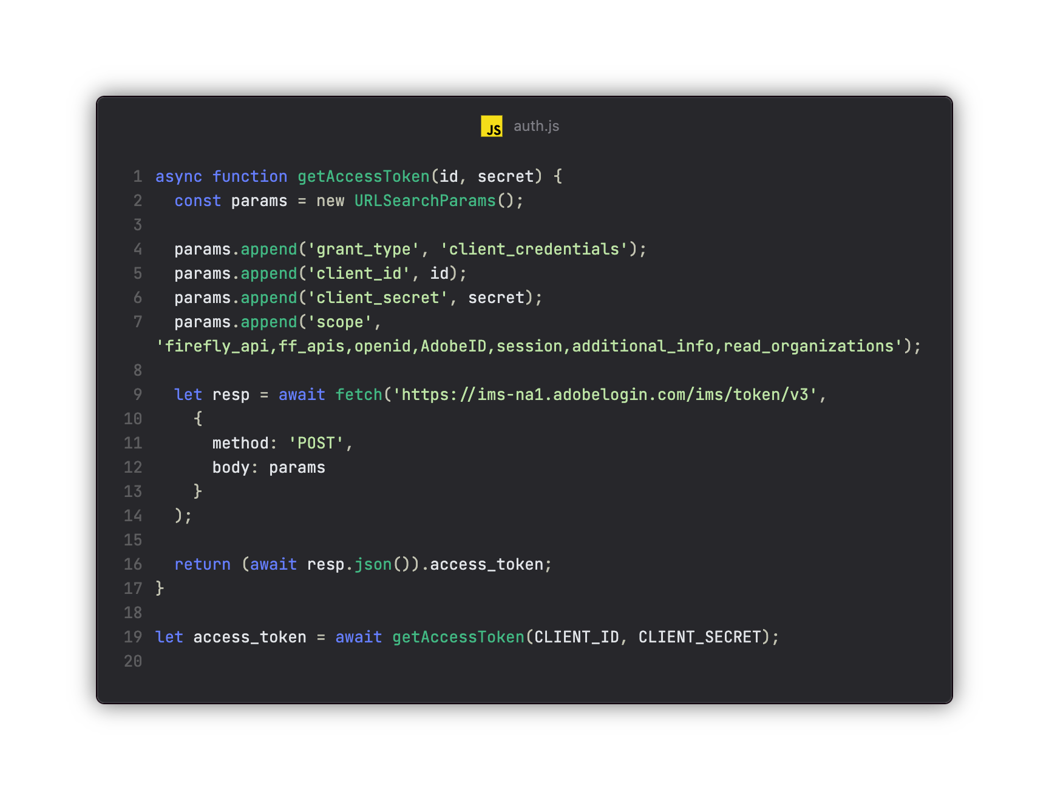
Getting an Access Token - Code

Slide 36
Demo
Run demos/basicauth.mjs
Notes:
Run the code, discuss the code, etc.

Slide 37
Making an API Call - Firefly
Check the reference for required vs optional results
Always includes CLIENT_ID and Access Token
Make your call
Handle the responses (URLs)
Notes:
Of note here is the synchronous nature of FF versus what we will see later with PS.
Of note here is results in URLs, you then need to download

Slide 38
Making an API Call – Firefly Text to Image
Text to image requires (at minimum) a prompt
Can specify sizes, number of results, multiple styling options
Reference: https://developer.adobe.com/firefly-services/docs/firefly-api/guides/api/image_generation/V3/

Slide 39
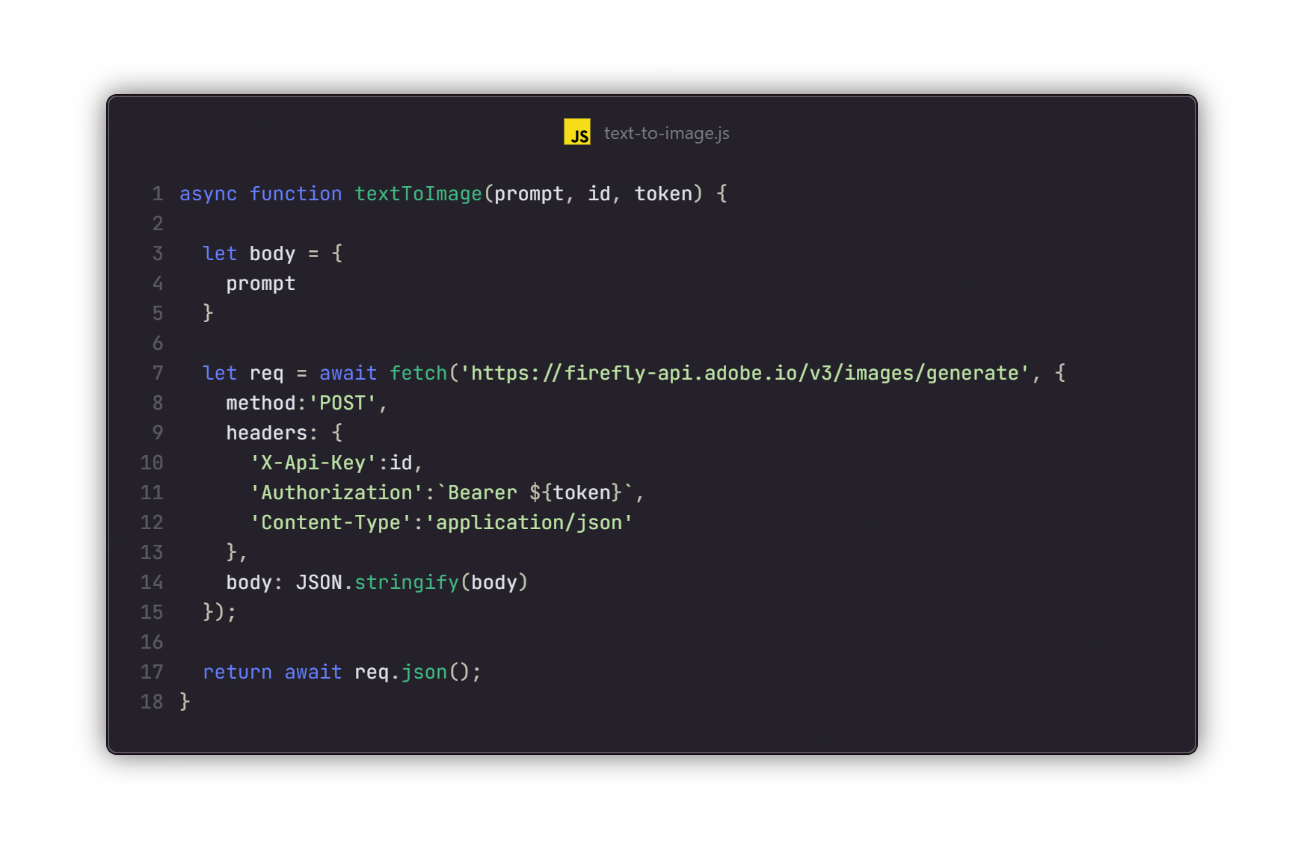
Example

Slide 40
Demo
Run demos/simple_text_to_image.mjs
Notes:
Run the code, discuss the code, etc.

Slide 41
Making an API Call – Firefly Generative Expand
Requires a source image
Prompt is optional
Can specify sizes, number of results, placement options
Reference: https://developer.adobe.com/firefly-services/docs/firefly-api/guides/api/generative_expand/V3/
Reference: https://developer.adobe.com/firefly-services/docs/firefly-api/guides/api/upload_image/
Notes:
One more example

Slide 42
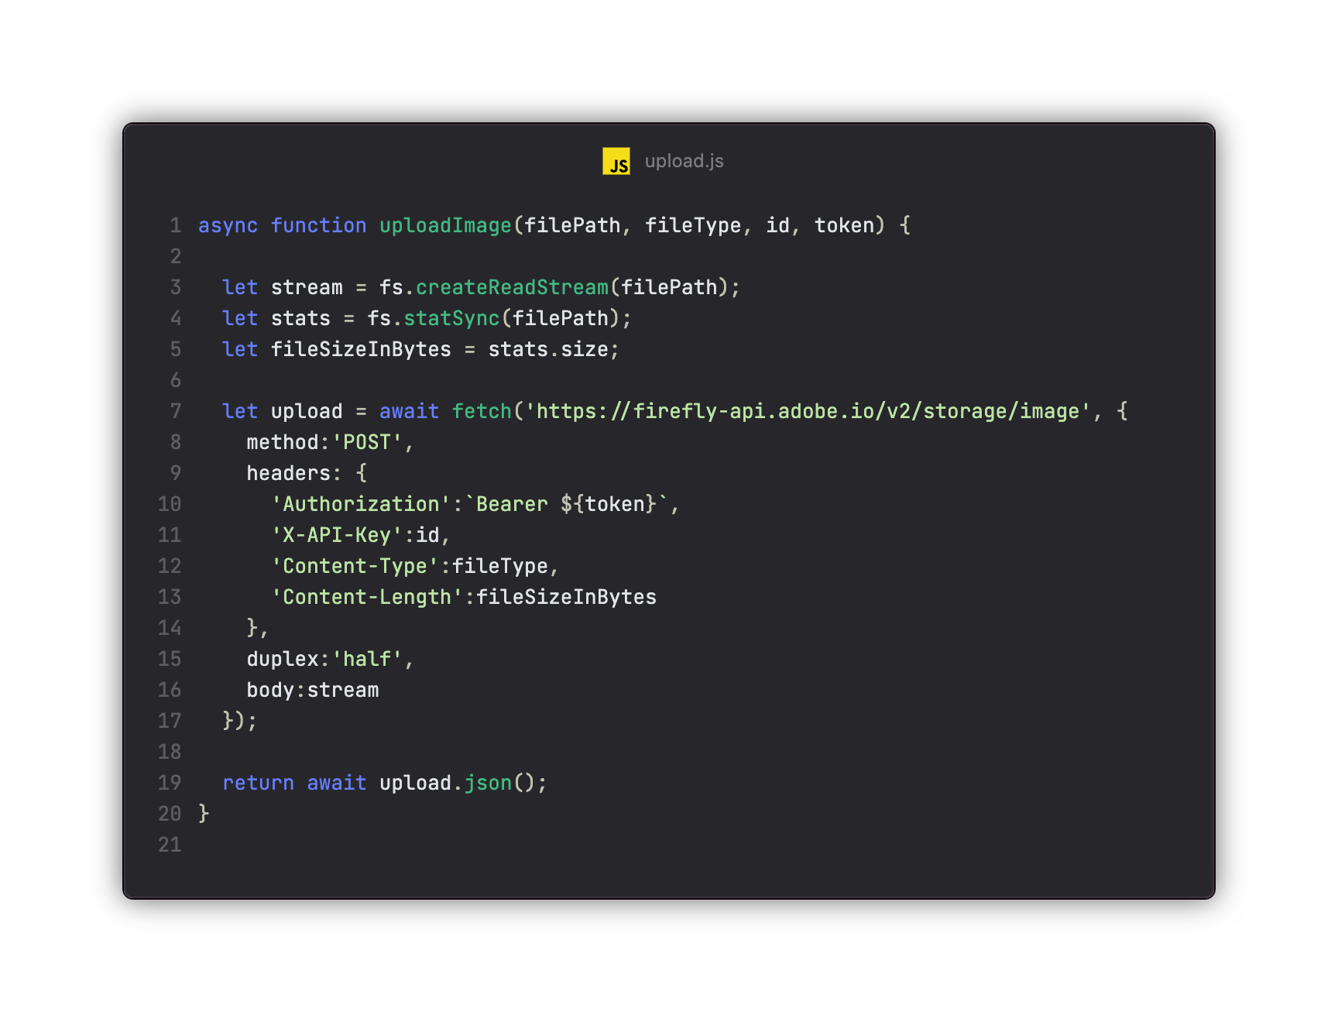
Example

Slide 43
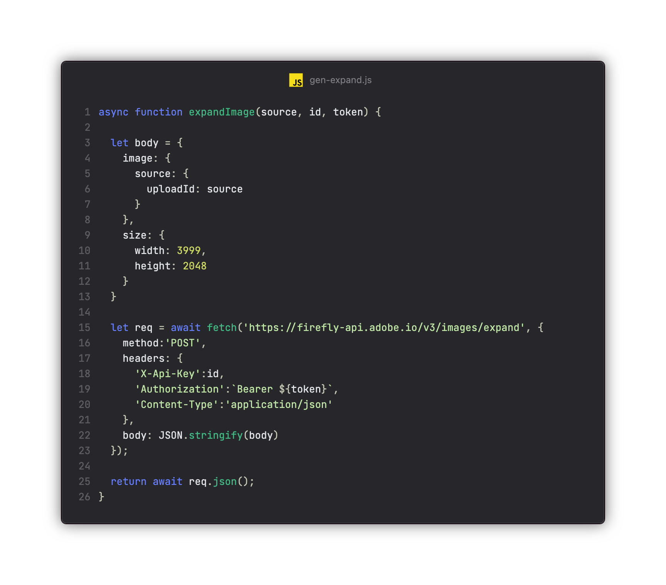
Example

Slide 44
Demo
Run demos/simple_expand_image.mjs
Notes:
Run the code, discuss the code, etc.

Slide 45
Making an API Call – Photoshop/Lightroom
Check the reference for required vs optional results
Ensure inputs are on cloud storage, and have a place for output
Always includes CLIENT_ID and Access Token
Make your call
Result is a “job” URL
Ping job URL for status
Notes:
Of note here is the synchronous nature of FF versus what we will see later with PS.
Of note here is results in URLs, you then need to download

Slide 46
Making an API Call –Lightroom AutoTone
AutoTone requires an input URL, output URL, and image type
Can specify quality
Reference: https://developer.adobe.com/firefly-services/docs/lightroom/api/lightroom_autoTone/
Note – will require SDK/custom code for your cloud storage

Slide 47
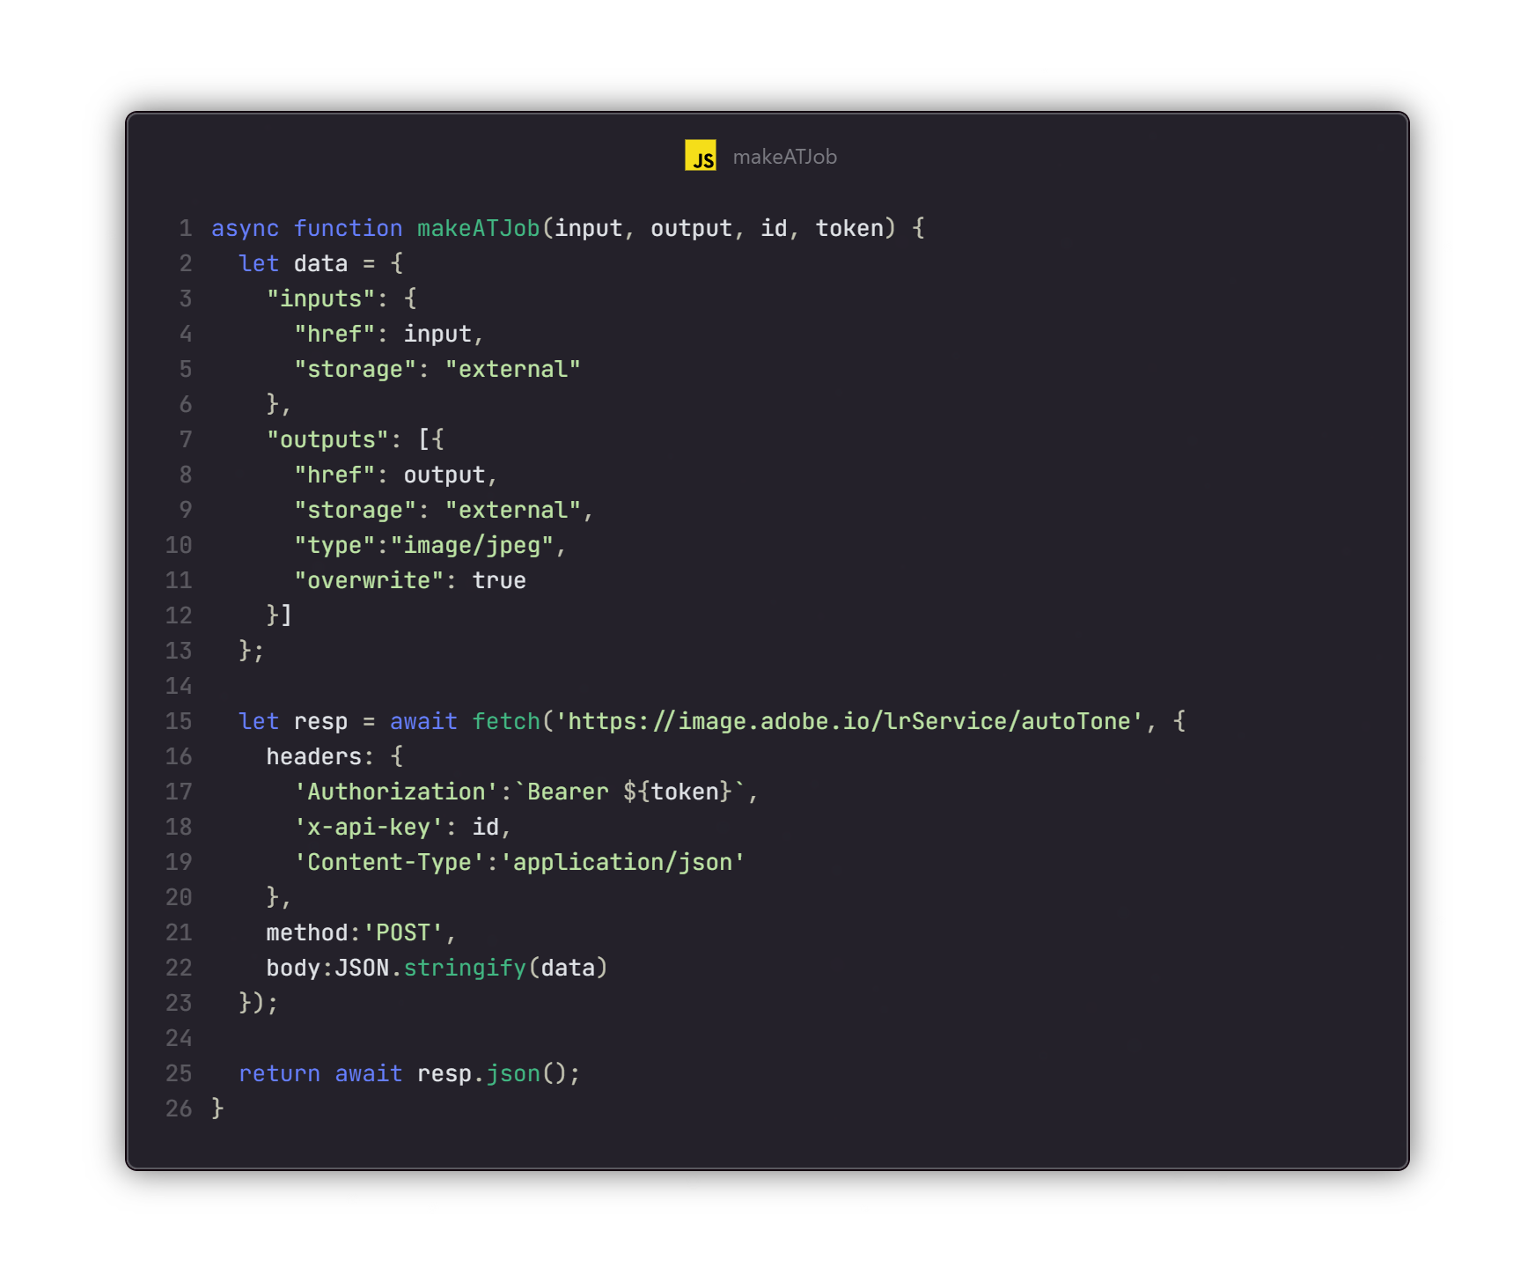
Example
Notes:
This example wraps a call to the endpoint, passing short lived urls for READ and WRITE and client id and token

Slide 48
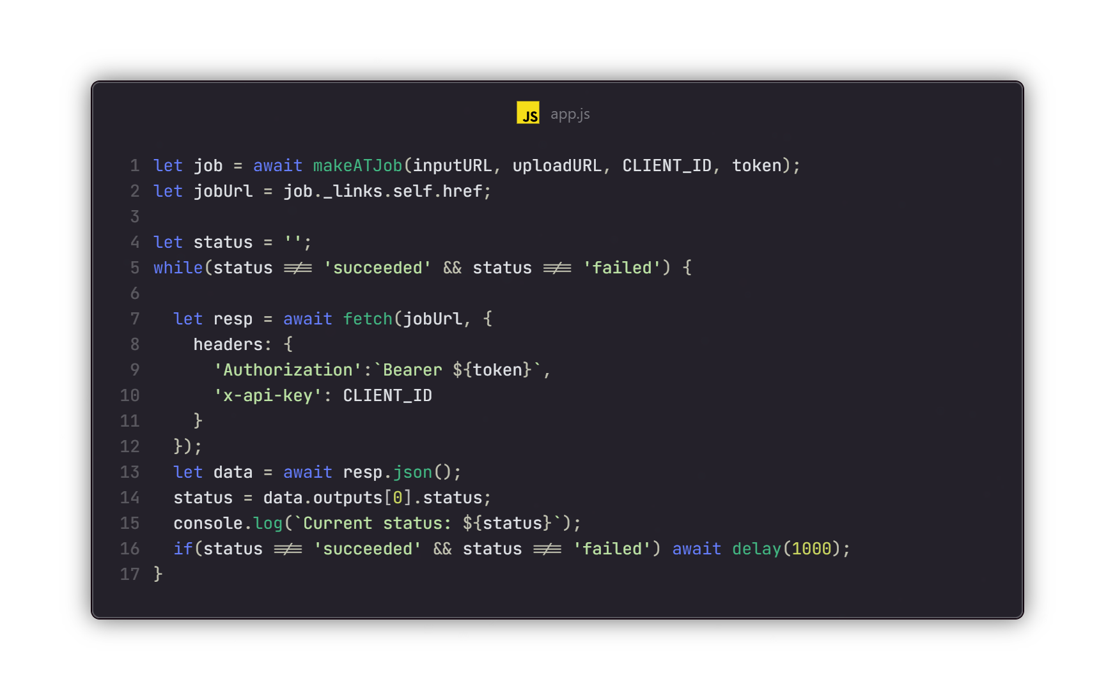
Example
Notes:
This example wraps a call to the endpoint, passing short lived urls for READ and WRITE and client id and token

Slide 49
Demo
Run demos/simple_autotone.mjs
Notes:
Run the code, discuss the code, etc.
Have bucket open in new tab

Slide 50
Putting it Together
If using PS/LR, prepare cloud storage
Coordinate the flow of assets from your source to Firefly/cloud storage
Build and test the workflow
Handle exceptions
Notes:
This is a general, high level summary of what a flow would look like, what you would need to do, etc. Probably obvious, but worth calling out imo

Slide 51
Workflow Example
Use Firefly to generate an image
Use Photoshop to render a thumbnail version*
Notes:
Note – using the PS API to make a thumbnail is overkill, but will help us illustrate a multi-API workflow.

Slide 52
Demo
Run demos/workflow_demo.mjs
Run demos/workflow_demo_2.mjs
Notes:
Run the code, discuss the code, etc.

Slide 53
Resources
Main Site (with links to docs) - https://developer.adobe.com/firefly-services/docs/guides/
SDK - https://developer.adobe.com/firefly-services/docs/guides/sdks/
Support – Your Rep!

Slide 54
Questions?
Notes:
Generic slide for questions, maybe also 5 minute break before labs

Slide 55
Labs

Slide 56
Exercises
For each lab, we will describe the requirements
But feel free to go beyond, change things up, and so forth!
You will have ten(ish) minutes, and then I’ll describe my solution
The GitHub repo contains solutions for each exercise if you get lost
Some will have multiple showing more advanced features

Slide 57
Exercise 1
Build an image generation tool using the Firefly API and a custom prompt
Pass in the prompt via the command line
Optionally save the results to the file system
Optionally use a file for input
Notes:
Remember to go the next slide as it has the auth code (and the slide after)

Slide 58
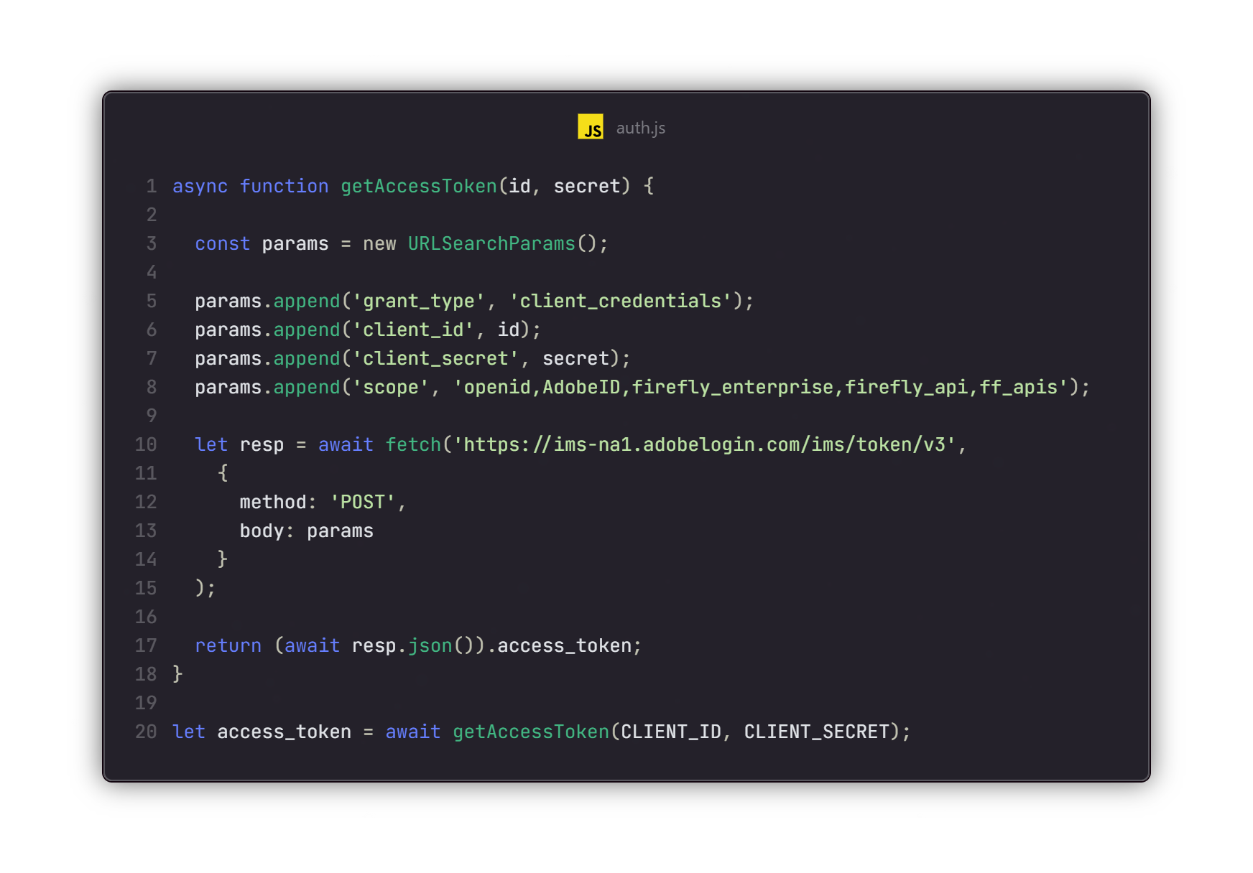
Reminder
Notes:
You can also find this code in the repo.

Slide 59
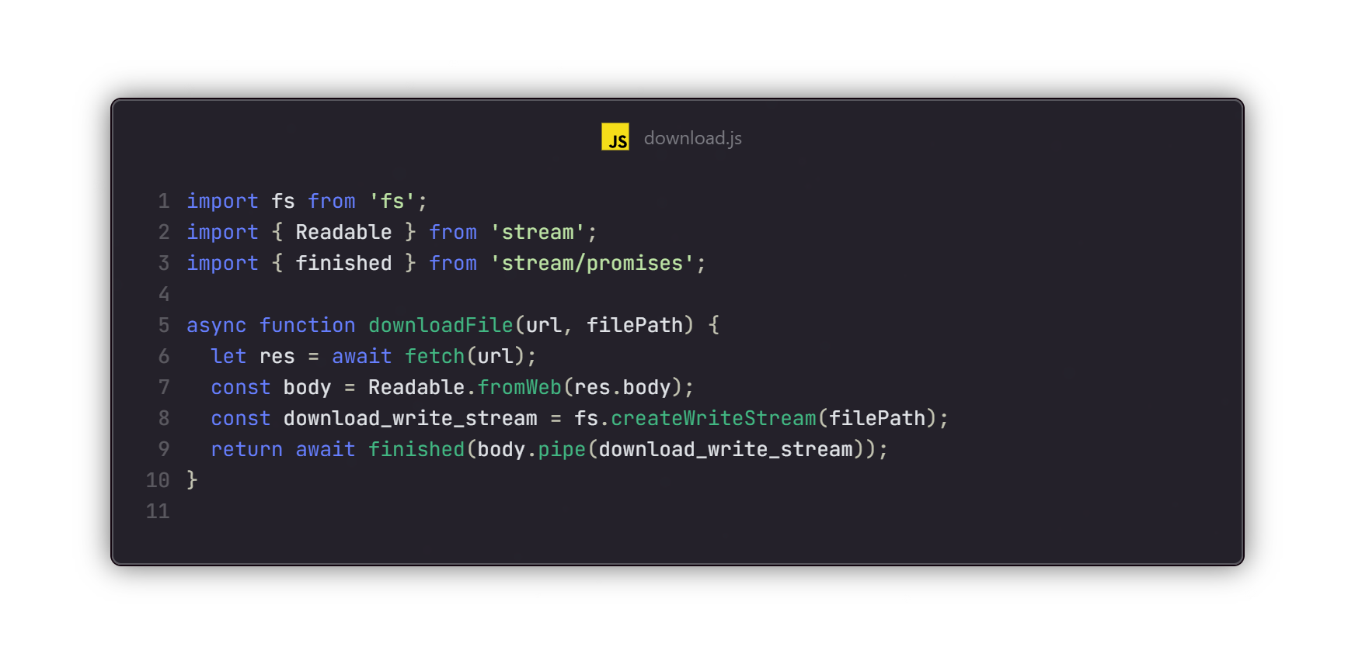
Downloading with Node
Notes:
This is MY implementation, could possibly be better

Slide 60
Exercise 2
Write code that scans a folder of images
Uploads them to cloud storage
Runs the Lightroom AutoTone on them
Saves results back to file system
Note: You can skip the “upload/download” part if you wish and just work in cloud storage.
GitHub repo has sample images in assets/totone

Slide 61
Exercise 3
Create a dynamically driven image creation tool
Read from a text file of prompts
For each prompt, generate one image (sized 1024 x 1024)
Then generate an expanded image (optionally create multiple different sizes)
Remember: The API creates URLs as outputs, and many methods support URLs as input

Slide 62
Exercise 4
Write code to automate background removal
Like Exercise 2, scan a folder and upload to cloud storage for processing
Again, you can download, or keep in cloud storage
How will you handle unique names?
GitHub repo has samples images in assets/removebg

Slide 63
Exercise 5
Builds on last lab
Take an image and remove the background
Generate a new image using a prompt and apply the main item from the previous image to the result
Again, you can download, or keep in cloud storage

Slide 64
Exercise 6
Given a source PSD file...
Use the “Apply PSD Edits” API to update text and output images
https://developer.adobe.com/firefly-services/docs/photoshop/api/photoshop_applyPsdEdits/
Process should pass in a set of tag lines (text file perhaps)
And generate output URLs for the various sizes

Slide 65
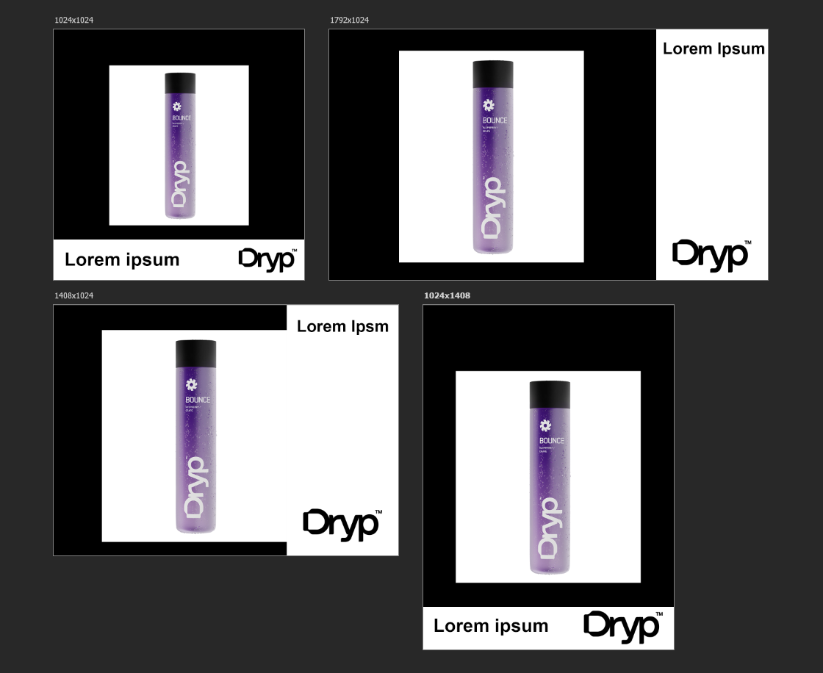
Notes:
Open PSD so they can see.
Ref: https://developer.adobe.com/firefly-services/docs/guides/tutorials/create-product-images-with-ff/

Slide 66
Final Questions?
My contact information:
Web: www.raymondcamden.com
Email: jedimaster@adobe.com
Slides, demos, and labs:
https://github.com/cfjedimaster/fireflyservices-preso
Notes:
Generic slide for questions, maybe also 5 minute break before labs

